Slide 1
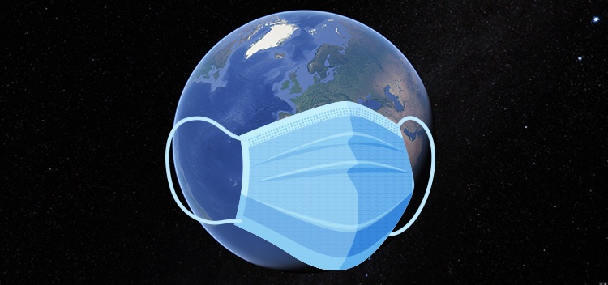
DETECTION OF PRECAUTIONS MEASURE FOR COVID-19
UNDER THE GUIDANCE OF-
MISS PRACHI AGARWAL
PROJECT BY-
DEEPANKUR SINGH
NUPUR GUPTA
PALAK GOEL
PALAK RASTOGI

Slide 2
OVERVIEW
PROBLEM STATEMENT
INTRODUCTION
METHODOLOGY
WORKING
CONCLUSION

Slide 3
PROBLEM STATEMENT
To detect whether a person wearing mask or not and follow the social distancing or not at the same time.
In this project we are implementing the two Modules
Module 1 : social distancing.
Module 2 : check whether a person wearing mask
or not.

Slide 4
INTRODUCTION
Social Distancing — the term that has taken the whole world by storm and is transforming the way we live. Social distancing also called “physical distancing”, means keeping a safe space between yourself and other people.
Social Distancing is here to stay longer than expected to fight Covid-19.
Wearing mask is another aspect that will lead to overcome the spread of Covid-19.

Slide 5
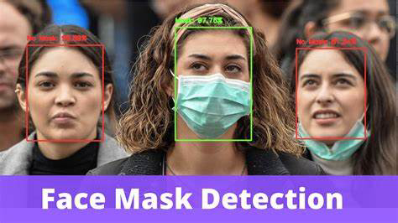
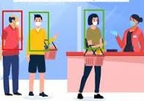
So this got our team
thinking to develop a
model to detect if people
are following social
distancing and at the
same time are wearing
Fig.1 Mask Detection masks or not.
Red bounding boxes indicate that the Person is in the proximity of another person so it will generate a message as “Alert” and the Green bounding box indicates the person is wearing masks and maintain social distancing.
Fig. 2 Social Distancing

Slide 6
METHODOLOGY
We can use OpenCV, Computer Vision to implement “social distancing ”detectors.
The steps to build a social distancing detector include:
Apply object detection to detect all people (and only people) in a video stream.
Compute the pairwise distances between all detected people.
Based on these distances, check to see if any two people are less than N pixels apart.

Slide 7
For face-mask detection we are suppose to do:
Fig. 3 Flow chart for training data
Fig. 4 Flow chart for testing and implementation of Model
LOCAL DATASET
TRAINED DATA BY ALGORITHMS
LOAD MODEL TO DISK
LOAD TRAINED MODEL
DETECT FACE IN CAPTURING VIDEO
EXTRACT EACH FACE ROI
APPLY TRAINED CLASSIFY ALGO
RESULTS WHETHER PERSONS FOLLOW PRECAUTIONS OR NOT

Slide 8
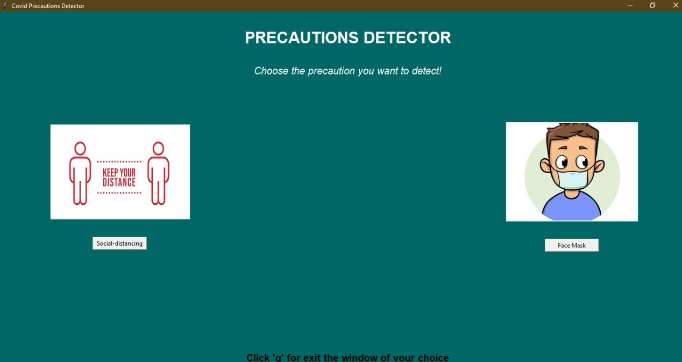
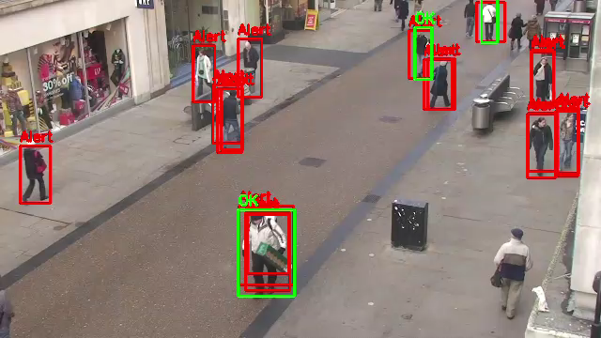
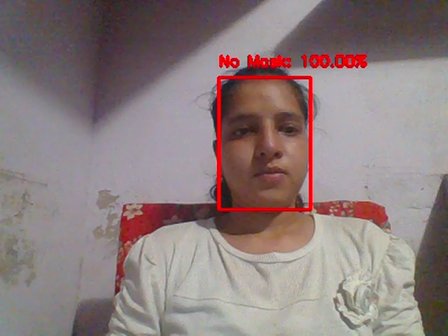
WORKING
This will judge social distance
This will detect face mask
Precautions Detector System

Slide 9
Conclusion
As this pandemic, is become part of our life and we must live with it. Here we are supposing to give a small support that lead to provide an ease in keeping an eye over the crowd and public places.
This project will judge the suspect easily and gives the result efficiently. It is helpful in judging all the parameters like distance between the objects (persons) and face of a person (“mask covering part”).

Slide 10
THANK YOU
THANK YOU

